Slide 1
RoBERTa or BERT
Student: Xuanyu Su
Supervisor: Isar Nejadgholi

Slide 2
TABLE OF CONTENTS
01
02
03
Recall of BERT
RoBERTa
Comparison
Pretrain steps
Why RoBERTa is better than Bert?
Comparison of structions

Slide 3
Recall of BERT
01
was created and published by Google in 2018.

Slide 4
What does BERT do during Pretrain?
MLM
NSP
BERT uses Masked Language Models (MLM) and Next Sentence Prediction (NSP)
masks 80% of the 15% of the randomly selected input tokens and uses the other tokens to attempt to predict the mask (missing word)
NSP is a binary classification loss for predicting whether two segments follow each other or are from different documents

Slide 5
RoBERTa
02
based on Google’s BERT model released in 2018.

Slide 6
Reasons why RoBERTa is better
1
2
3
More training data
Prediction without NSP
4
Dynamic masking
Longer Sequences
16G(BERT)
vs
160G(RoBERTa)
Uses dynamic masking
pattern instead of
static masking pattern
Replacing next
Sentence prediction
objective with full
sentences without NSP
Training on Longer Sequences

Slide 7
1. More Training Data
RoBERTa
BERT
uses BookCorpus (16G),
CC-NEWS (76G), OpenWebText (38G) and Stories (31G) data
uses BookCorpus (16G) as training data only

Slide 8
2. Dynamic Masking Pattern Static Masking Pattern
VS
RoBERTa
BERT
Static Masking is where the same mask is used and not changed while Dynamic Masking Pattern masks the data differently
Better!
Dynamic Masking Pattern masks the data differently

Slide 9
3. FULL-SENTENCES without NSP
FULL-SENTENCES without NSP
SENTENCE-PAIR with NSP
A pair of sentences from the same or different documents. It is slightly different from the original BERT approach. The number of token is significantly less than 512.
Inputs are packed with sentences that are sampling from one or more documents. When training data is reached the end of document, sentences from other documents will be sampled. The number of token is at most 512. use!
RoBERTa

Slide 10
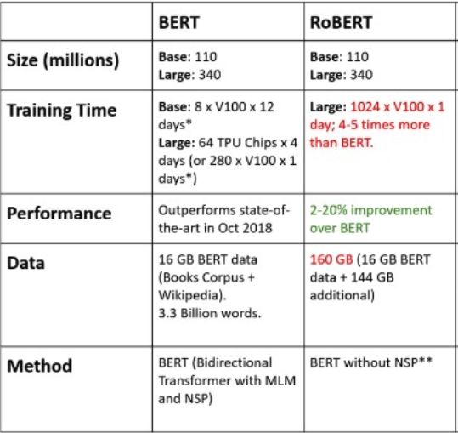
Comparisons BERT & RoBERTa

Slide 11
4. Training on Longer Sequences
RoBERTa
BERT
trained 125K steps with 2k sequences
is trained through 1 million steps with a batch size of 256 sequences

Slide 12
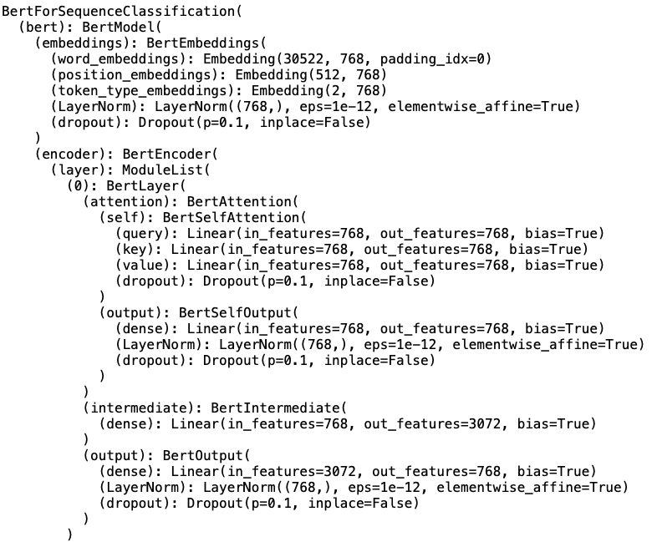
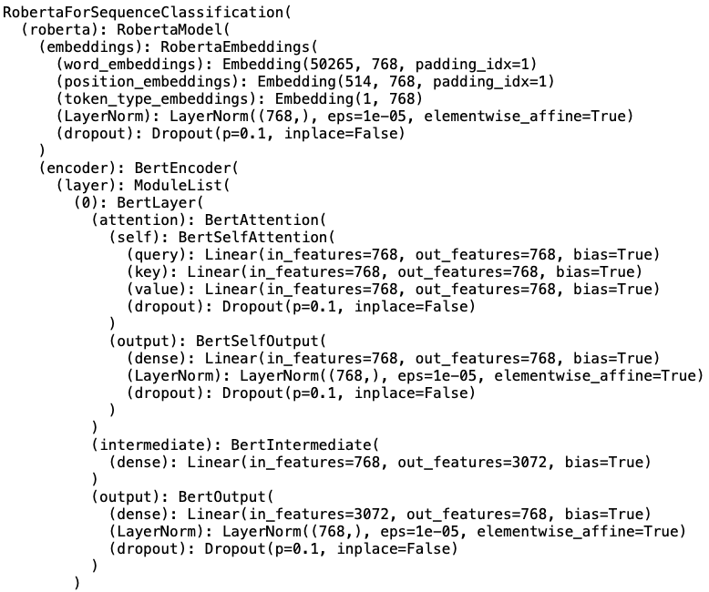
Comparison of structures
BERT
RoBERTa
The only difference is the embedding
input size

Slide 13

When specific to ‘SequenceClassification’ model
BertForSequenceClassification
RobertaForSequenceClassification
One linear layer in BERT
Two linear layer in RoBERTa

